Slide 1














Output Tag
Name: Nazeeb Ahmed Chowdhury
Roll: 1432
Name: Sejuti Sharmin Siddique
Roll:1420

Slide 2

Table of Contents
01
02
03
04
Introduction
Working methodology
CODE
Backward Compatibility

Slide 3

Intoduction
The <output> HTML tag is used to represent the result of a calculation or user interaction with a form.
It is designed to display dynamic values, such as results from form inputs or JavaScript operations, without needing to refresh the page.
The tag is often used in combination with other interactive elements like <input>, <button>, and <form>.

Slide 4

Working methodology
1.Association with Form Elements:
The <output> element can be associated with one or more form controls using the for attribute. This allows it to display results related to those controls.
2.JavaScript Interaction:
JavaScript can be used to perform calculations or manipulate data entered by the user, and the result can be displayed inside the <output> tag by updating its value property.

Slide 5

Code Example

Slide 6
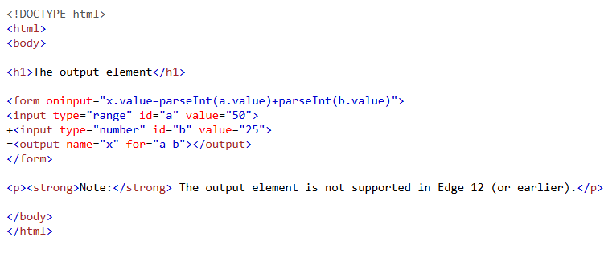
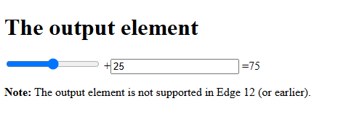

Slide 7
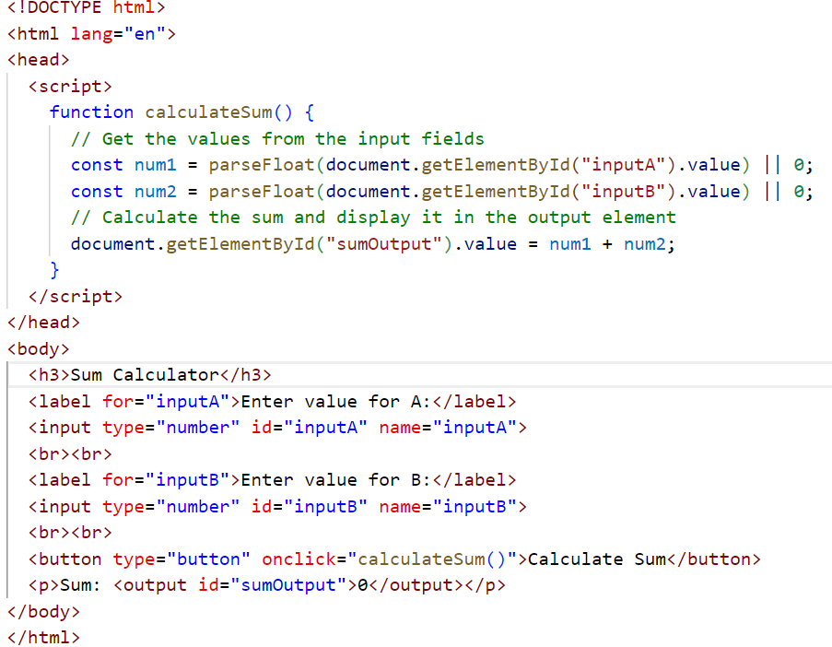
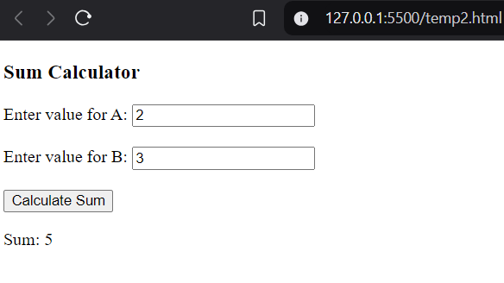

Slide 8
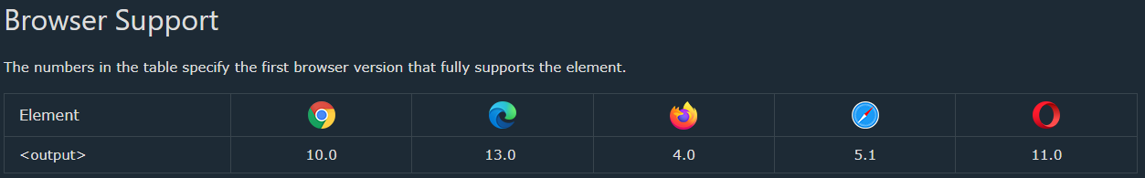
Backward Compatability
HTML5 Introduction:
The <output> tag was introduced in HTML5, meaning it is not present in older versions of HTML (such as HTML 4).
Browser Support:
Modern browsers like Chrome, Firefox, Edge, and Safari fully support the <output> tag.
However, older browsers (pre-HTML5) may not recognize this element.

Slide 9
Thank you very much!

